Slide 1
La Musique
Unit 14

Slide 2
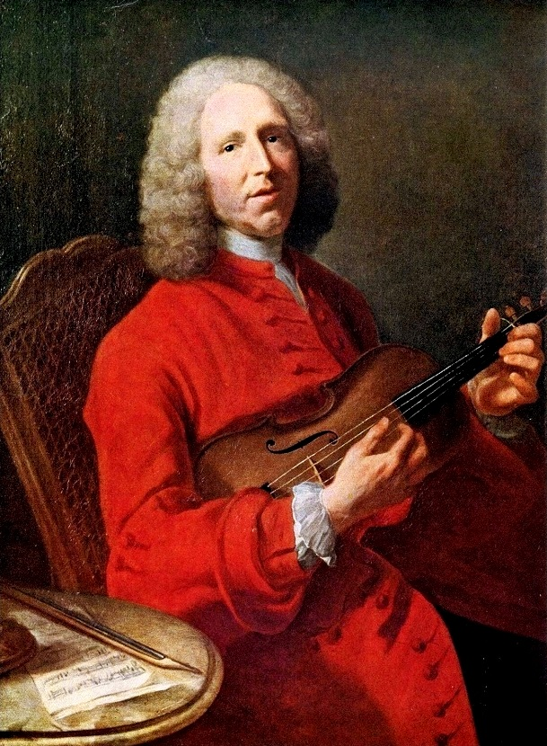
Baroque
Jean Philippe Rameau

Slide 3
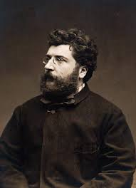
Romanticism
Georges Bizet

Slide 4
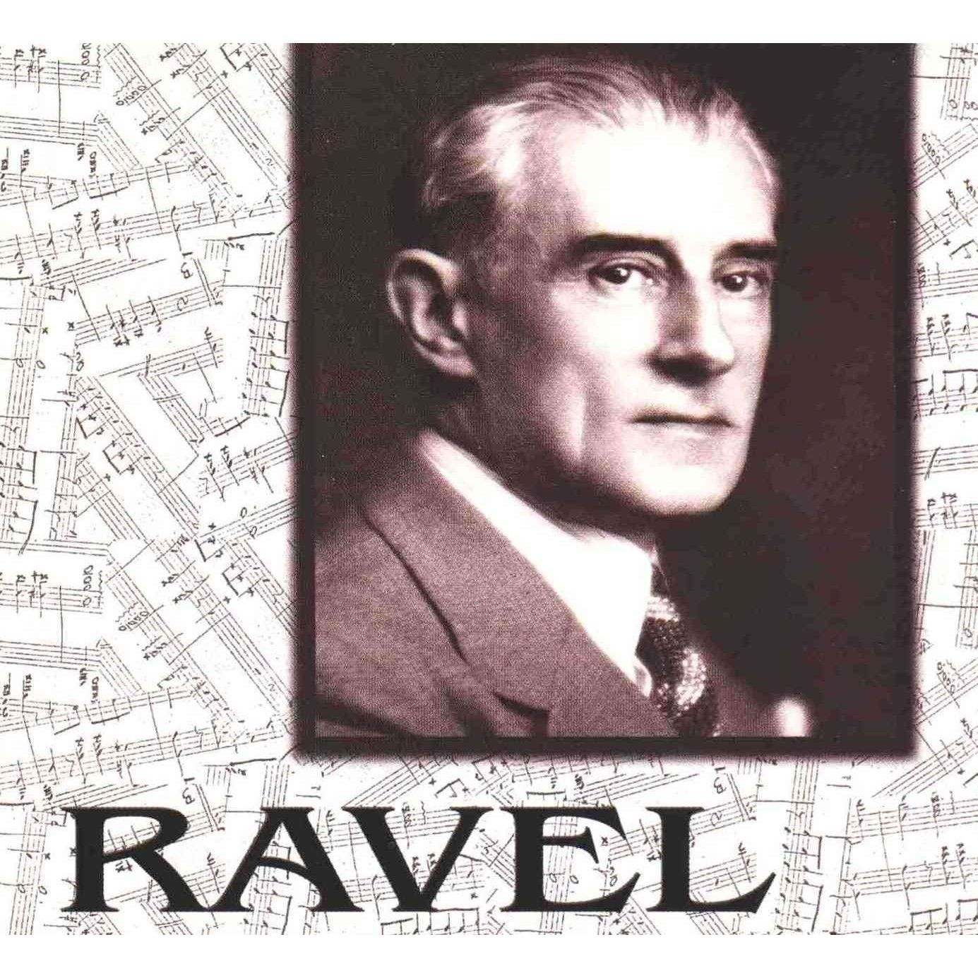
Impressionism
Maurice Ravel

Slide 5

Popular Music
Contemporary Rock
Manau

Slide 6

Traditional Music
Gypsy Kings

Slide 7

Traditional Music
Le Rai

Slide 8
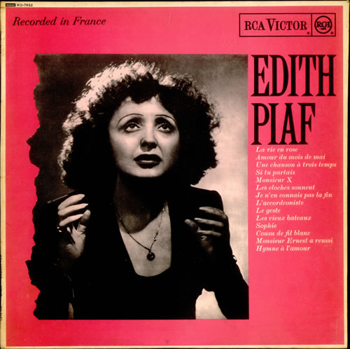
Entertainment World
Edith Piaf

Slide 9
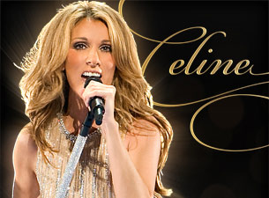
Entertainment World
Celine Dion

Slide 10
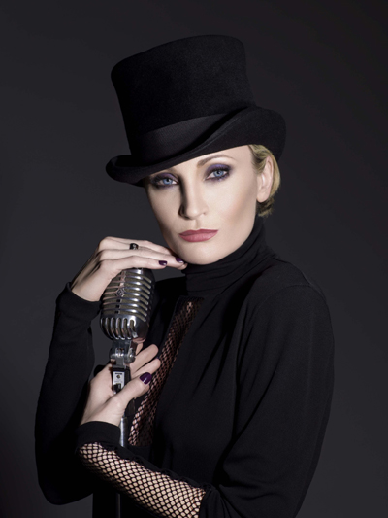
Entertainment World
Patricia Kaas

Slide 11

Entertainment World
Angelique Kidjo

Slide 12
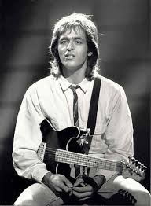
Entertainment World
Jean-Jacques Goldman

Slide 13
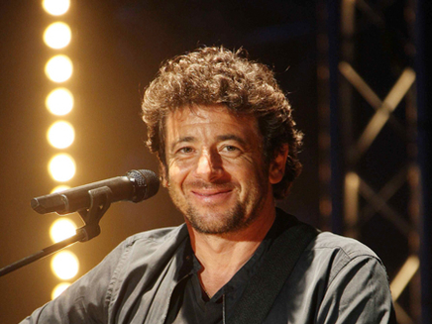
Entertainment World
Patrick Bruel

